Slide 1


Slide 2
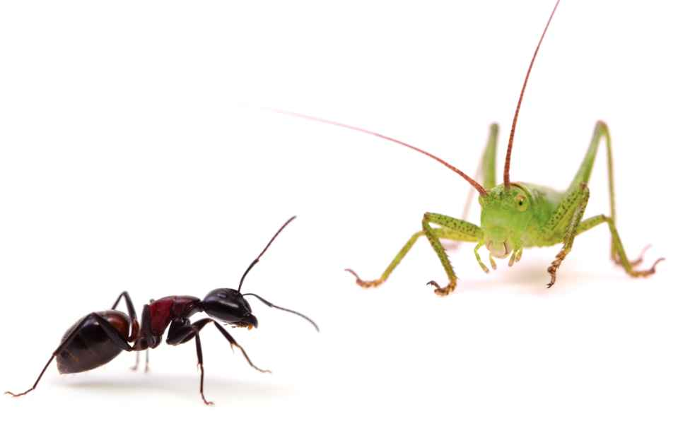
All fables have one and the same origin- real life!
Each of them reflects situations and people from daily life. So,these fables may be some useful lessons for our behavior.

Slide 3

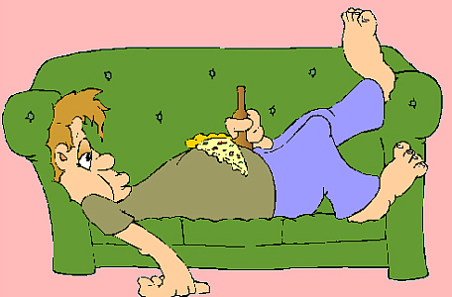
Does it really pay best to work or be idle?
Of course to get money while you do nothing to obtain them is more than pleasant. But the life don’t means spending money that aren’t done by you.
Money obtained from working seem more valuable. When you know that money come from the work, the satisfaction of their possession increases.

Slide 4
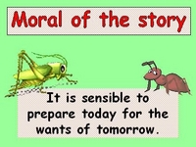

Slide 5

The author of the text, W. Somerset Maugham shows an variable attitude in this text. Earlier he manifested a compassion to the eldest of the brothers, George. For some reason, in the end, it becomes close with Tom. Maybe, this oscillation is caused by hypocrisy and materialism, profiteering instincts?

Slide 6
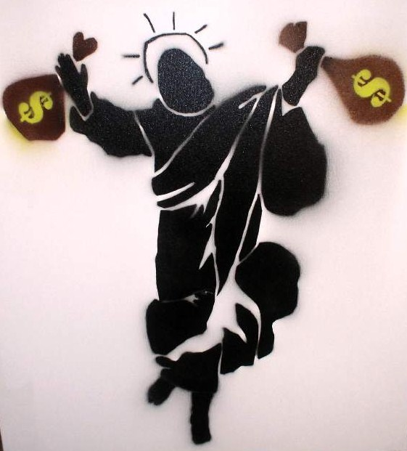
Nothing exposed by the author does not seem to be exaggerated, as the text, unfortunately, may correspond to reality .Thus, in this case is welcome proverb: "Success Makes a Fool seem wise ..."

Slide 7
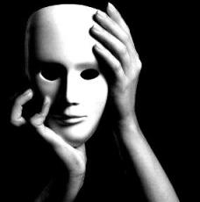
If I find myself in any of those three situations presented in the text: the author, George, Tom, sure things were to be different. Instead author, who began pity George, and when Tom enriched, he spent his time with him. I think it could be better if he were neutral at least
It is remarkable mentality of George, because indeed work makes man and it is a guarantee of a decent future, but if I was George, er so be restrained against brother and let him learn to count only himself.
Instead Tom, who start a family, it was resonable to take responsibility as the head of his family and to not leave. It was also better to show a respectful attitude toward his brother .

Slide 8

Having a brother is most precious and most honorable gift. The relationship of brotherhood should be the tightest and harmonious connection because the brothers have the same origin, they come from a single blast, single miss.

Slide 9
REALISED BY: Vudvud Ana Cociug Mihaela

